Slide 1

HIT THE CHARTS

Slide 2
HIT THE CHARTS
What music features make songs go brrrr?
Analysing and modelling
Spotify Streaming charts.

Slide 3

ESTABLISHING
A NEW ARTIST
ARTIST
WHATS THE FIRST SINGLE?
MGMT
LABEL
PR / PUBLICIST

Slide 4
A DECISIVE PICK
1 Decisive in establishing a new artist or album
2 A single is spearheading the promotional campaign
3 It’s a very disputed topic between all stake holders
4 It is a major financial commitment :
music video production
spending on social media ads
media plugging form online to radio

Slide 5
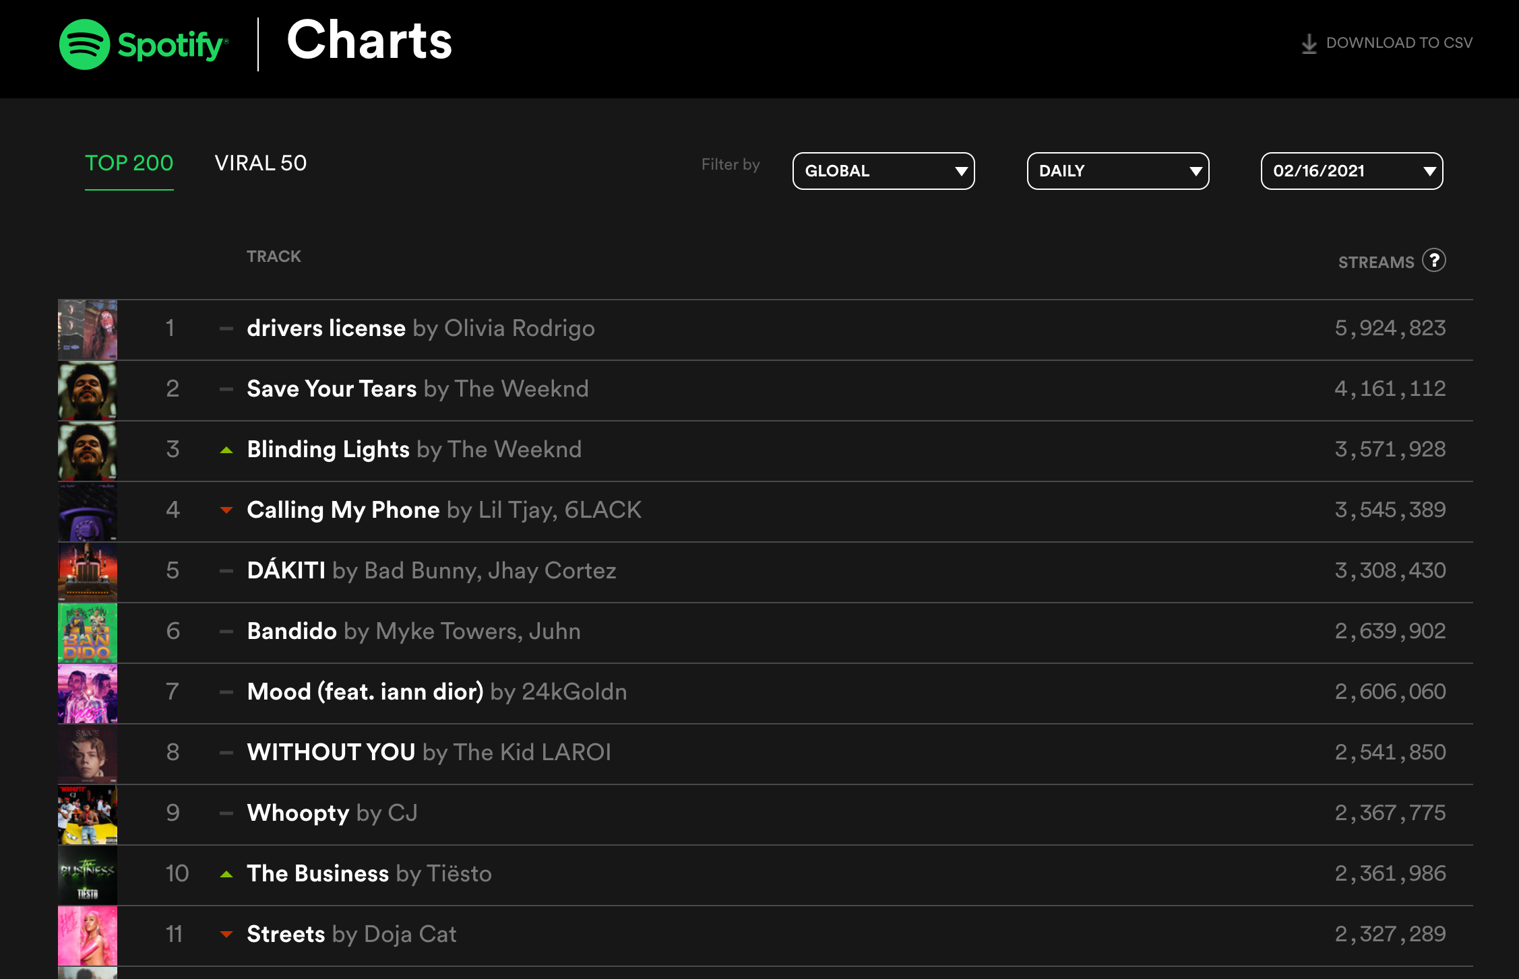
33 COUNTRIES
01/01/2018 -
31/01/2021
TOP 50
EVERY 90 DAYS
9.000
UNIQUE SONGS

Slide 6
ANALYSIS

Slide 7

·Danceability
·Acousticness
·Energy
·Instrumentalness
·Liveness:
presence of an audience
·Tempo: (BPM).
·Valence: positiveness
·Loudness in decibels (dB)
·Speechiness:
presence of spoken words

Slide 8
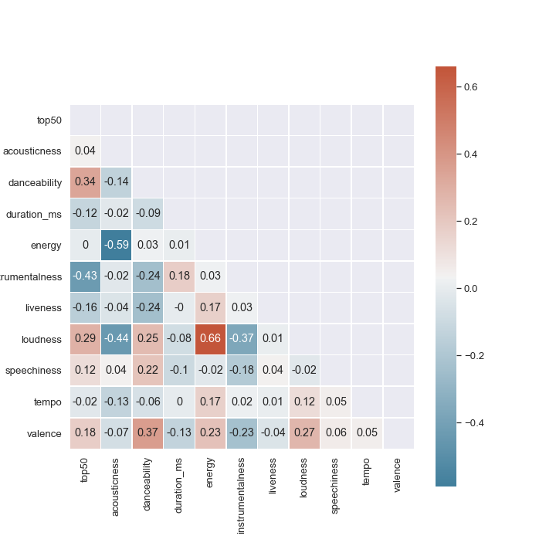
TOP 50 SONGS

Slide 9
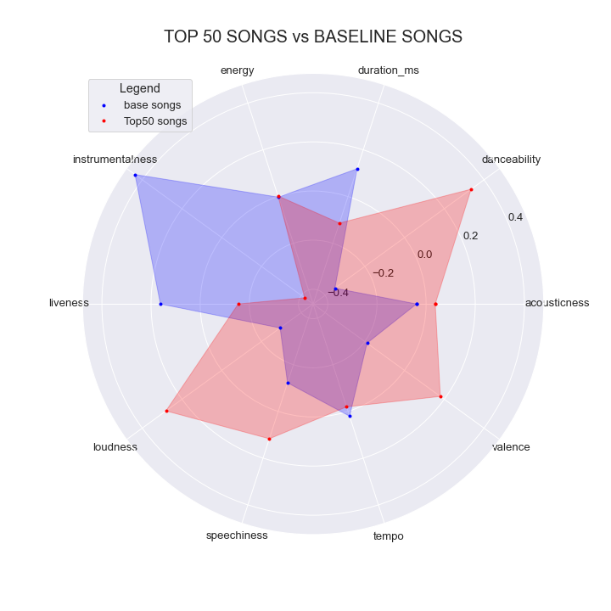
COMPARISON

Slide 10
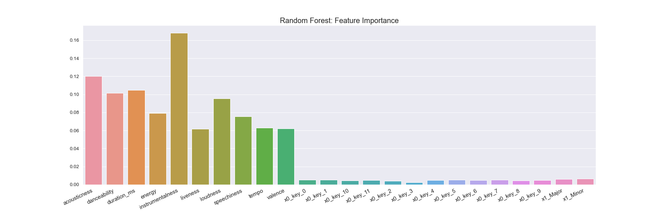

FEATURE IMPORTANCE

Slide 11
MODEL COMPARISON

Slide 12
